Slide 1

Design of a Robotic gripper for top motor mount engine
MDM Group Project
STEFANIA GERMENA
CHIARA MAGNASCO
CHIARA MASANIELLO

Slide 2
Goals and requirements
GRIP STABILITY
  Geometric analysis of the top motor mount
  Identification of graspable areas
  Definition of functional requirements (stability, adaptability)
  Definition of geometric requirements (Jodell Motor limitations)
  Selection of the most suitable gripper architecture and materials
SUITABLE MEASUREMENTS
DESIGN OF THE MECHANISM
2

Slide 3
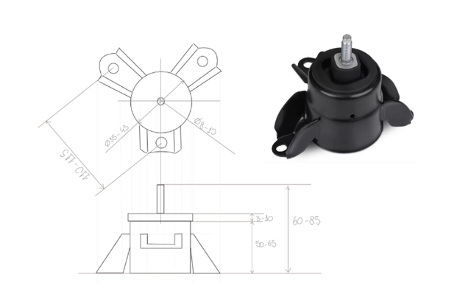
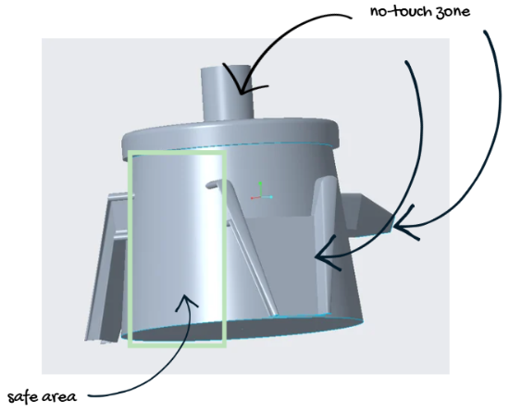
Component characteristics
Front upper motor mount
  Central cylindrical body
  Top threaded screw
  Three radial flanges (petals)
Non touchable:
  Threaded Screw
  Bolt Sections
  Painted Surfaces (Top half)
3

Slide 4
Requirements for the Design of the Gripper
  Materials choice → for a stable and adaptable grasp
  Non-planar motion → due to the geometry of the component
  Converting planar motion (sliding motors) to non-planar motion (radial motion)
EACH GRIPPER DESIGN CONSIDERS THE FOLLOWING:
  Ease of manufacturing
  Minimal packaging and assembly
  Conduct maintenance in an efficient manner
  The choice of material and design should be appropriate to handle the
  stresses applied
4

Slide 5
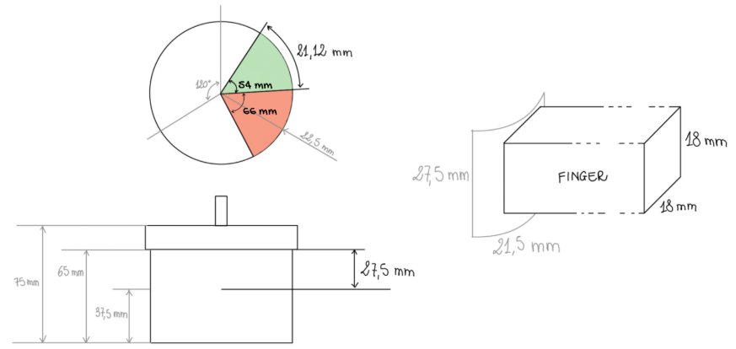
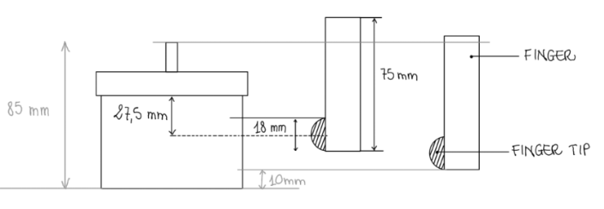
Measurements
Based on these geometric constraints, we defined a standard finger tip contact area that fits within an 12mm x 18mm square to maintain a safety margin from the flange edges.
The equidistant petals/flanges provide a secure contact zone at every 120°.
5

Slide 6
Design options
O1
O2
O3
O4
  Piston to umbrella mechanism
  3 fingers + spring mechanism
  “iris” inspired mechanism
  Modular Half-moon slider architecture
05
06
07/08
09
6
  HALF MOON + pulley system
  Slotted guide
  Button design
FINAL DESIGN CHOICE
6

Slide 7
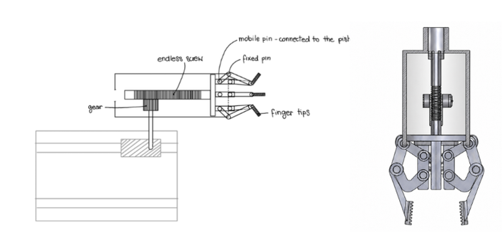
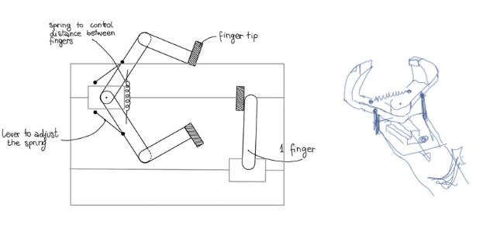
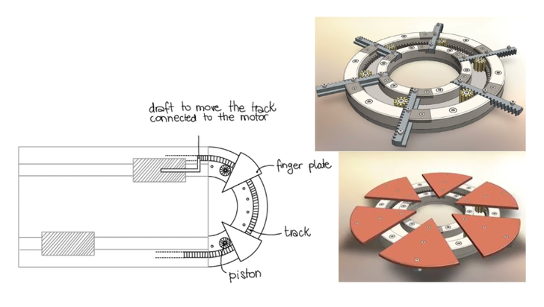
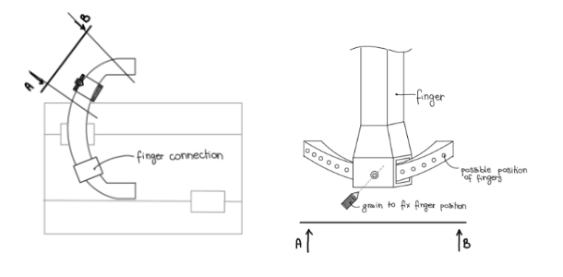
Design options
OPTION 1:
PISTON TO UMBRELLA MECHANISM
OPTION 2:
3 fingers + spring mechanism
OPTION 3:
“iris” inspired mechanism
OPTION 4:
MODULAR “HALF-MOON” ARCHITECTURE
7

Slide 8
Reasons for exclusion
OPTION 1:
PISTON TO UMBRELLA MECHANISM
OPTION 2:
3 fingers + spring mechanism
Reasons for exclusion:
  Large number of individual components
  Difficulty in assembly and transportation
  Complicated design
  Time-consuming a design
Reasons for exclusion:
  Difficulty in finding the correct spring material and stiffness to balance both the grasping force and the weight of the load.
  Required initial set-up
OPTION 3:
“iris” inspired mechanism
OPTION 4:
MODULAR “HALF-MOON” ARCHITECTURE
Reasons for exclusion:
  Perfect synchronization between the components needed to guarantee uniform movement and adaptability
  Complex to model
  Too many components
Reasons for exclusion:
  Best balance of simplicity and modularity. However, it requires a long initial manual setup
8

Slide 9
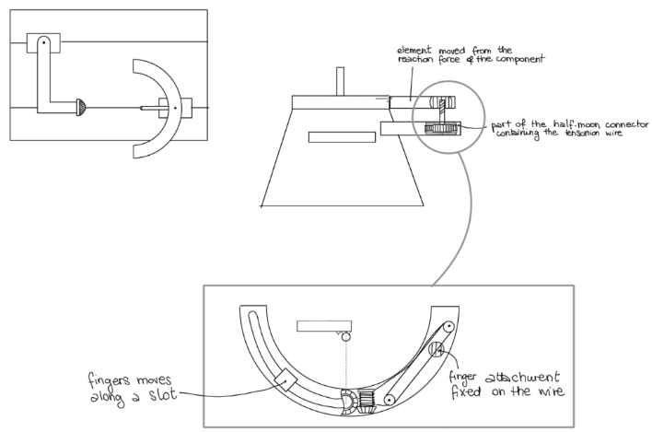
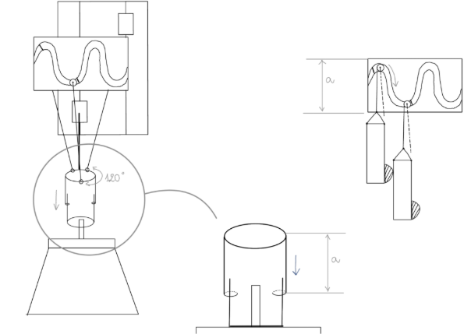
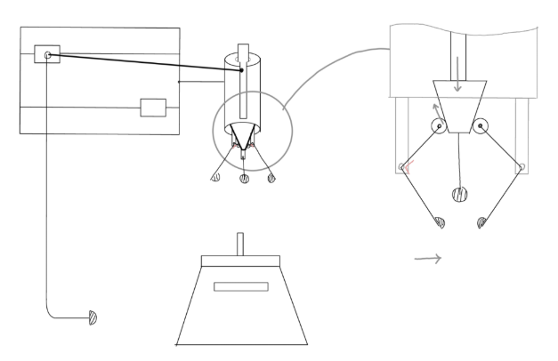
Additional design options
After the review of previous options, we altered our designs to better match the expectations of the assignment. The following were considered.
OPTION 5: HALF MOON + PULLEY SYSTEM
OPTION 6:
SLOTTED GUIDE
OPTION 7/8:
BUTTON DESIGN
9

Slide 10
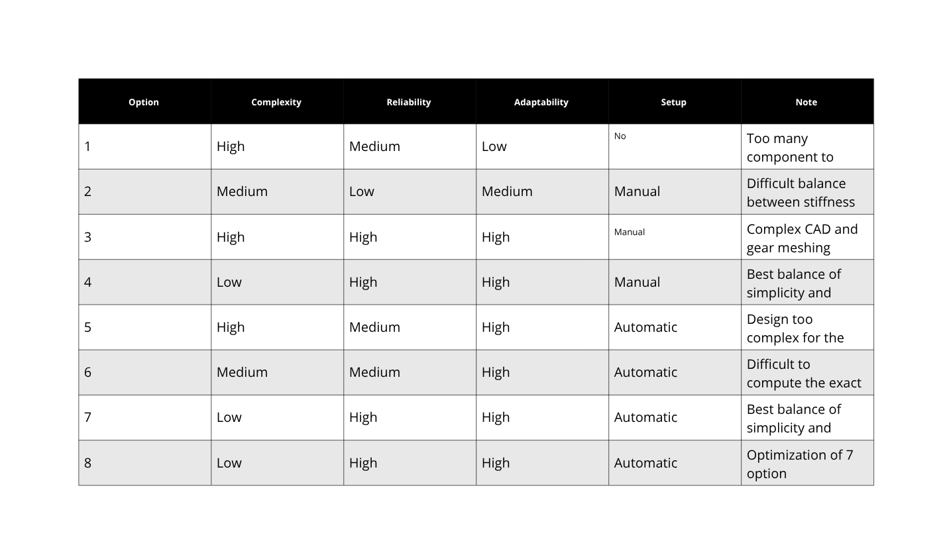
Additional design options
Complete evaluation of the options 1-8
10

Slide 11
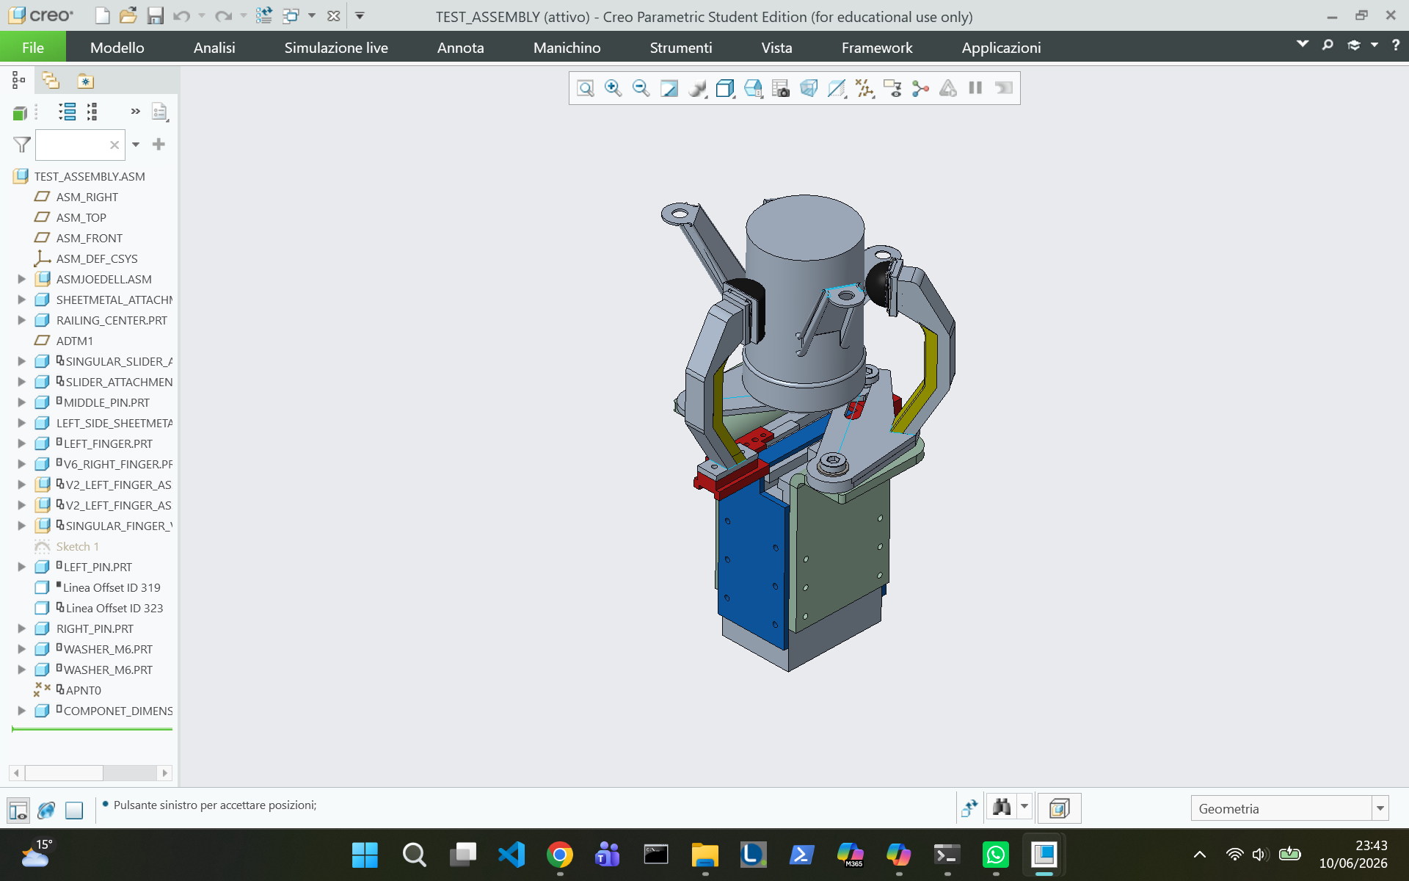
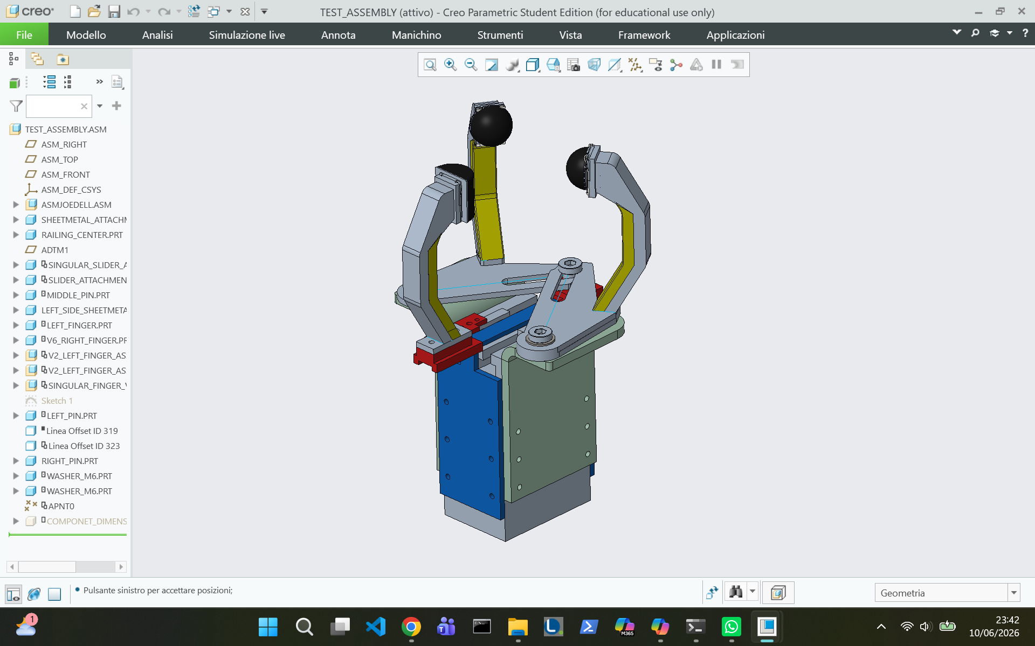
FINAL DESIGN
CHOICE
OPTION 9: THREE FINGER SLOT MECHANISM
Three-finger architecture,
One finger moving linearly and two fingers guided through rigid bars and slots.
11

Slide 12
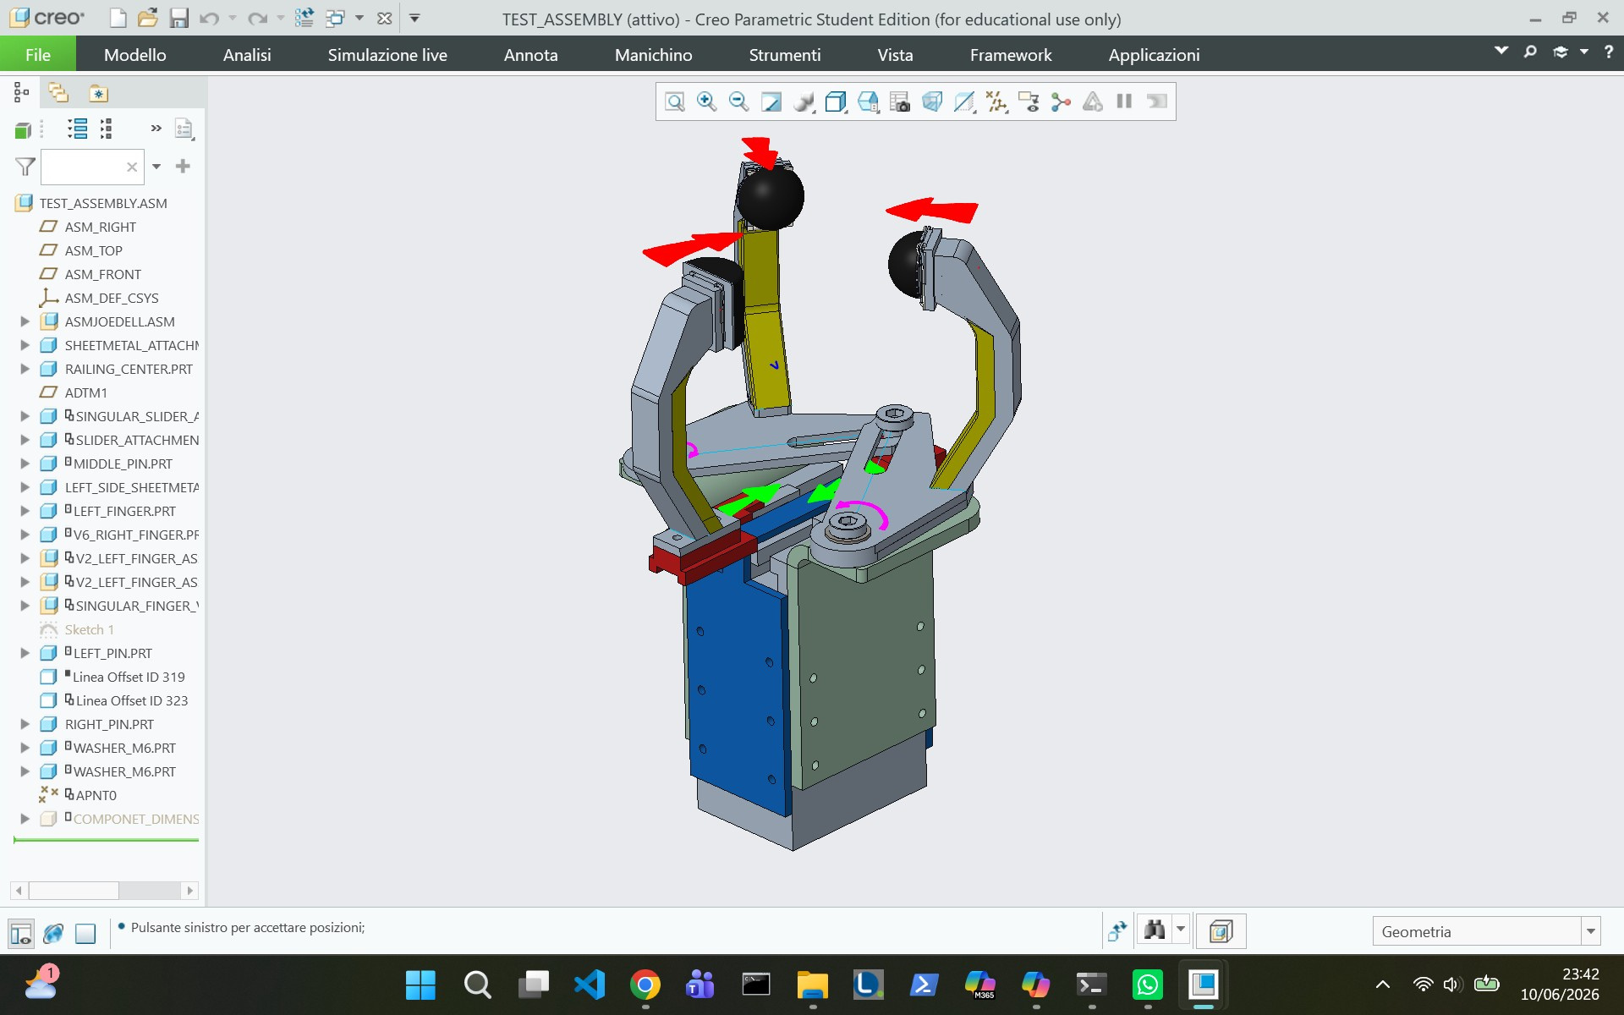
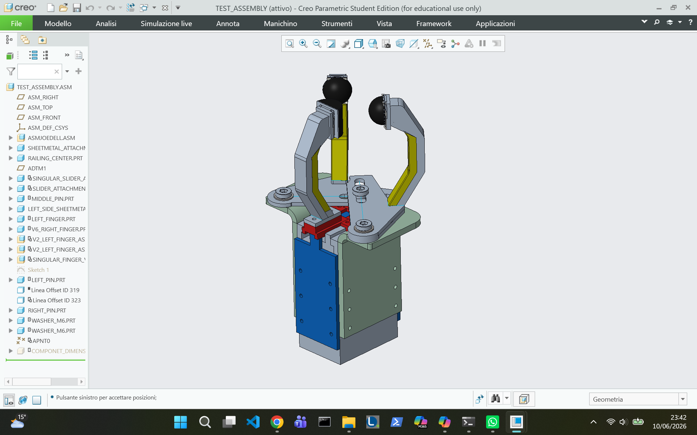
Design architecture
Three fingers slot mechanism
  Three-finger architecture
  One linear finger + two fingers guided through rigid bars and slots
  Motor-driven mechanism with sheet metal structure
  Snap-fit fingertips with rubber attachment for grip
The chosen achitecture results in a radial motion that seamlessly adapts to different object sizes, without significantly increasing the mechanical complexity.
12

Slide 13
Key Features
The final design was selected for its adaptability to different sizes, minimal initial setup requirements, and ease of maintenance — making it the most practical and scalable solution among the evaluated options.
Adaptability
Easy setup
Simple design
Grip stability
Low mantainance
13

Slide 14
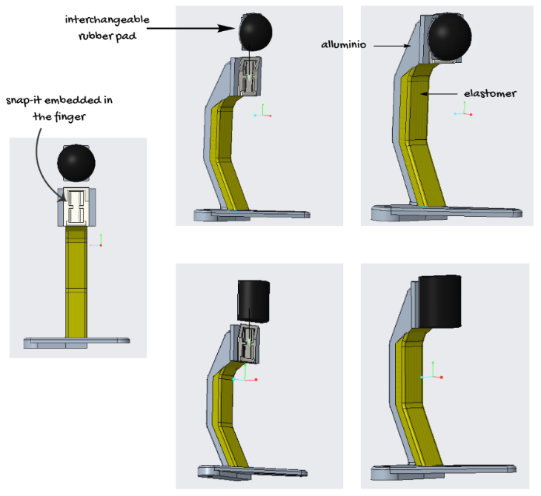
Fingers
FINGER MATERIALS:
Each finger combines a stiff load‑bearing material with a deformable layer that enhances stability
  An external metal component that supports the force applied by the object
  An interior silicone/elastomer element to enhance stability.
14

Slide 15
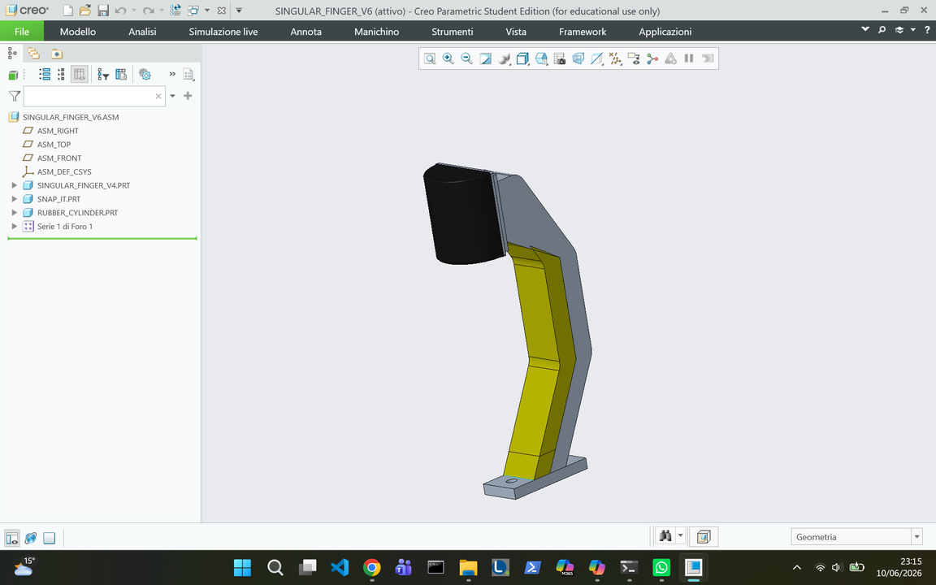
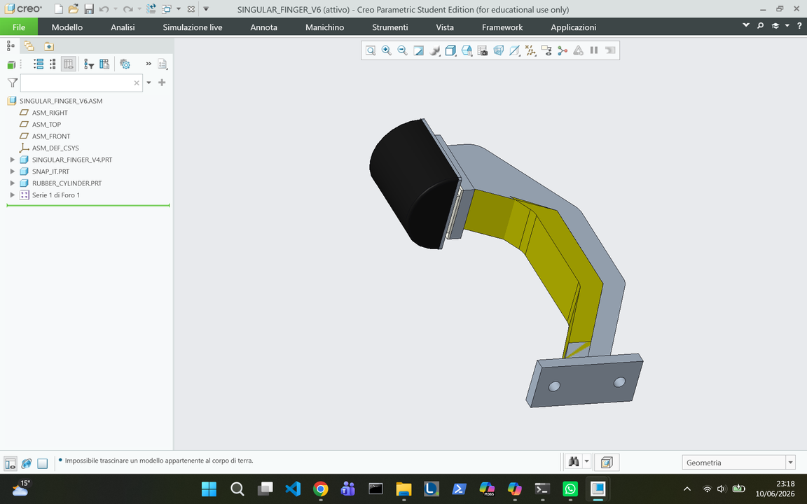
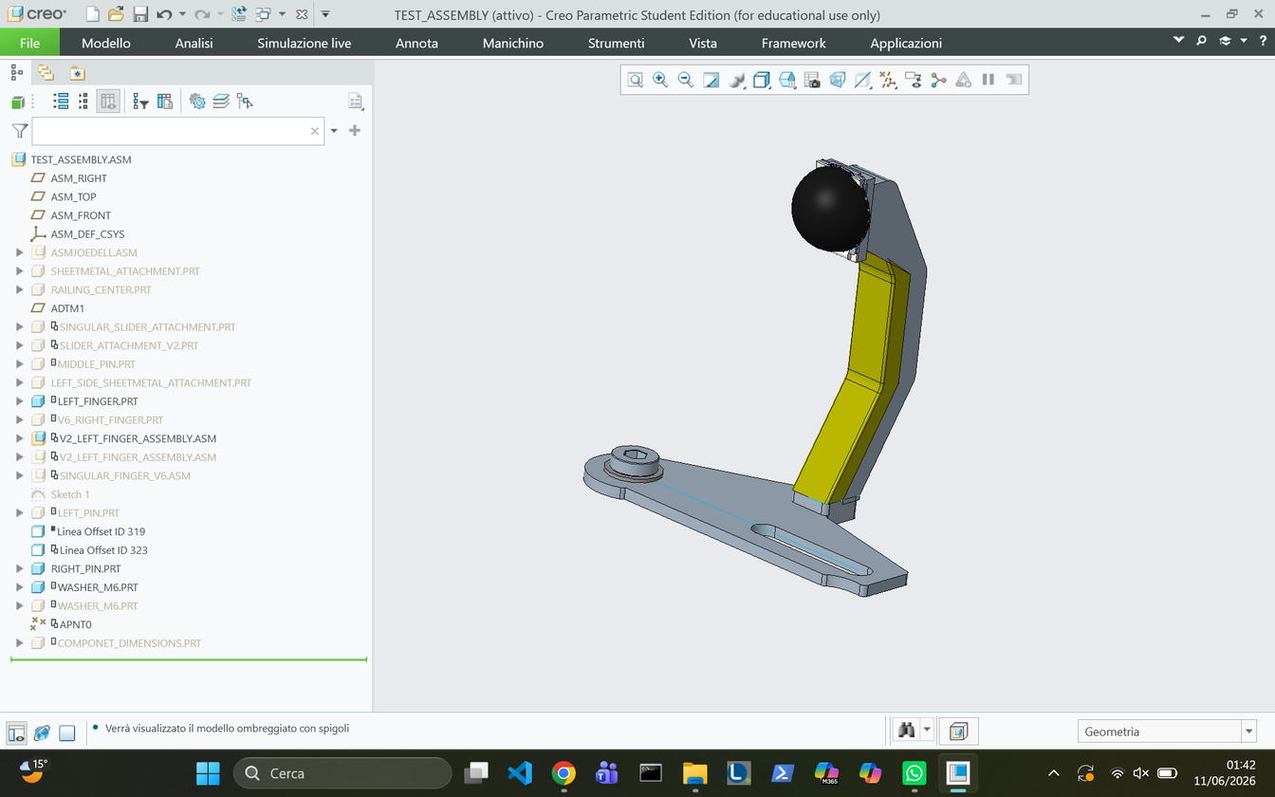
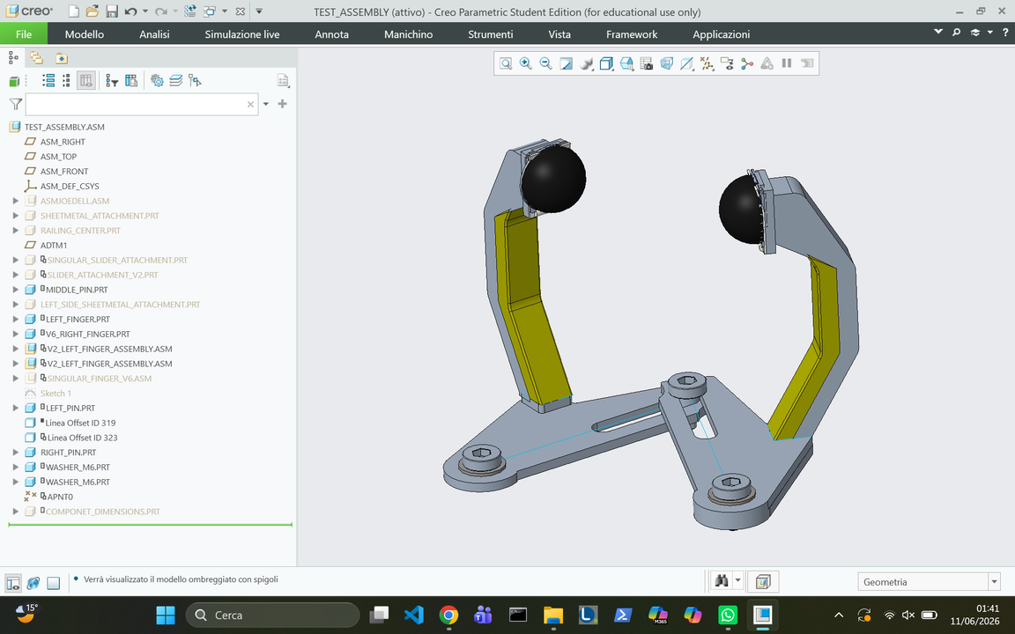
Fingers
SINGLE FINGER:
ROTATING FINGERS:
Additional skrews to counteract the bending moment of the finger
Pivot pins allowing the rotation of the two fingers
15

Slide 16
Finger tip
RUBBER PAD:
  Protects the surfaces of the component, absorbs vibrations, and secures the grip.
TYPES OF RUBBER ATTACHEMENT:
  Spherical: attached to the two fingers. Acts as a contact point.
  Cylindrical: attached to the singular finger. Reduces risk of tilting or bending movements. Assists in stability thanks to a larger surface area; therefore, always in contact with the component.
16

Slide 17
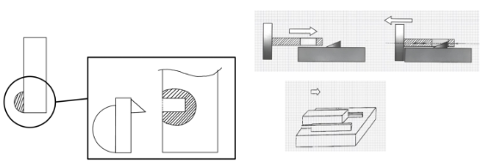
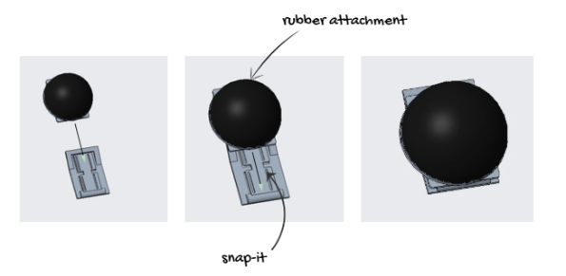
Finger tip
SNAP-FIT:
A snap-fit mechanism is used to secure the rubber attachment. It is larger than the final contact area of the finger, as the rubber attachment covers an area of 18 mm². It is secured to the part with 4 countersunk screws, to ensure ease of assembly and stability.
BENEFITS OF THE SNAP-FIT:
  The pad remains in the correct position throughout motion, preventing any accidental detachment during the pickup.
  Easy replacement of the rubber attachment without the need to disassemble the gripper.
17

Slide 18
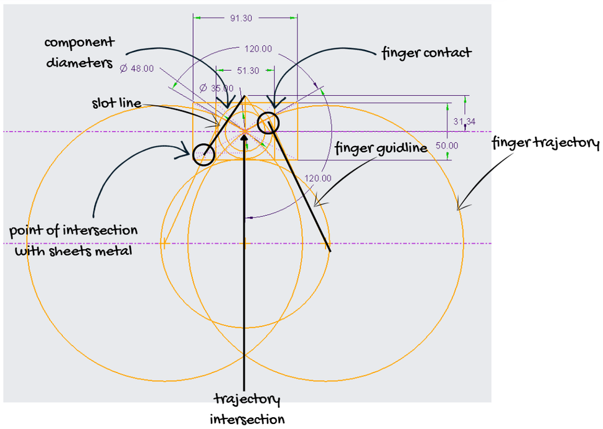
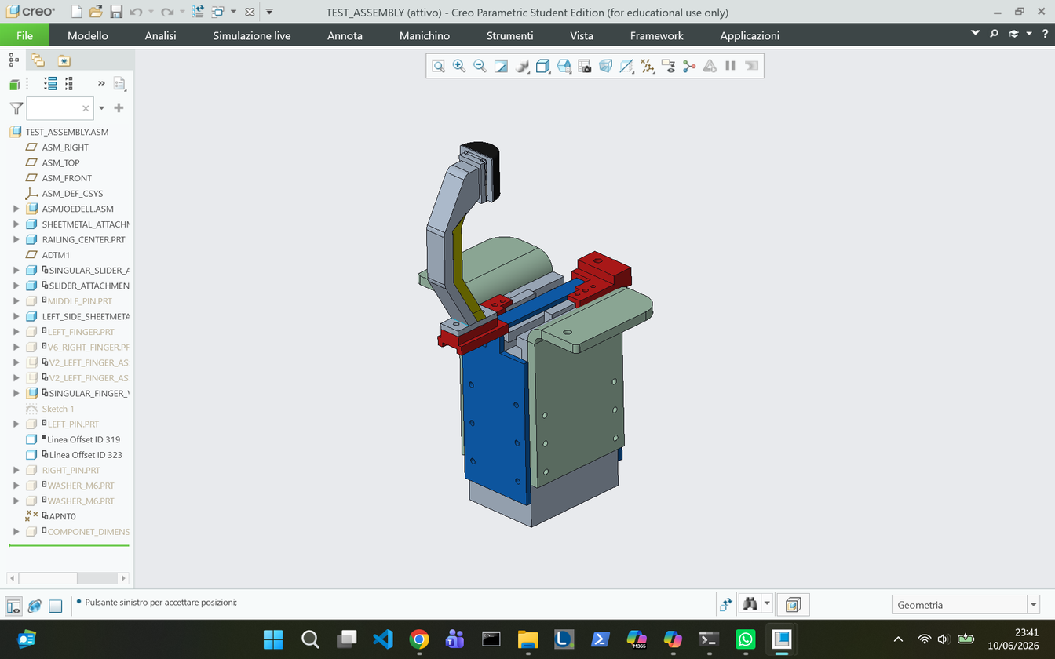
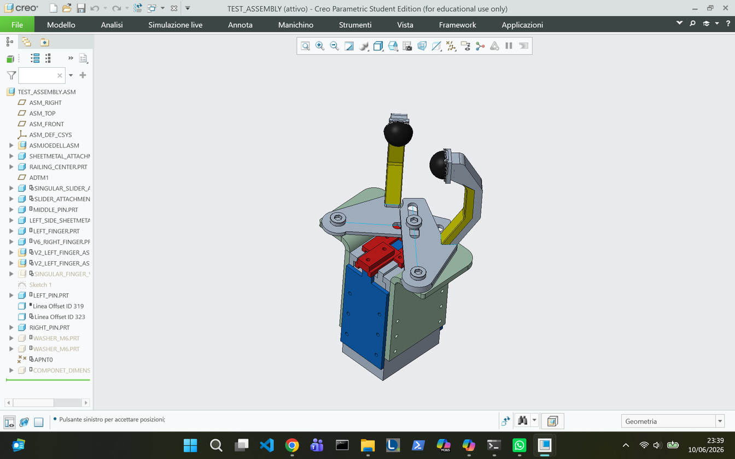
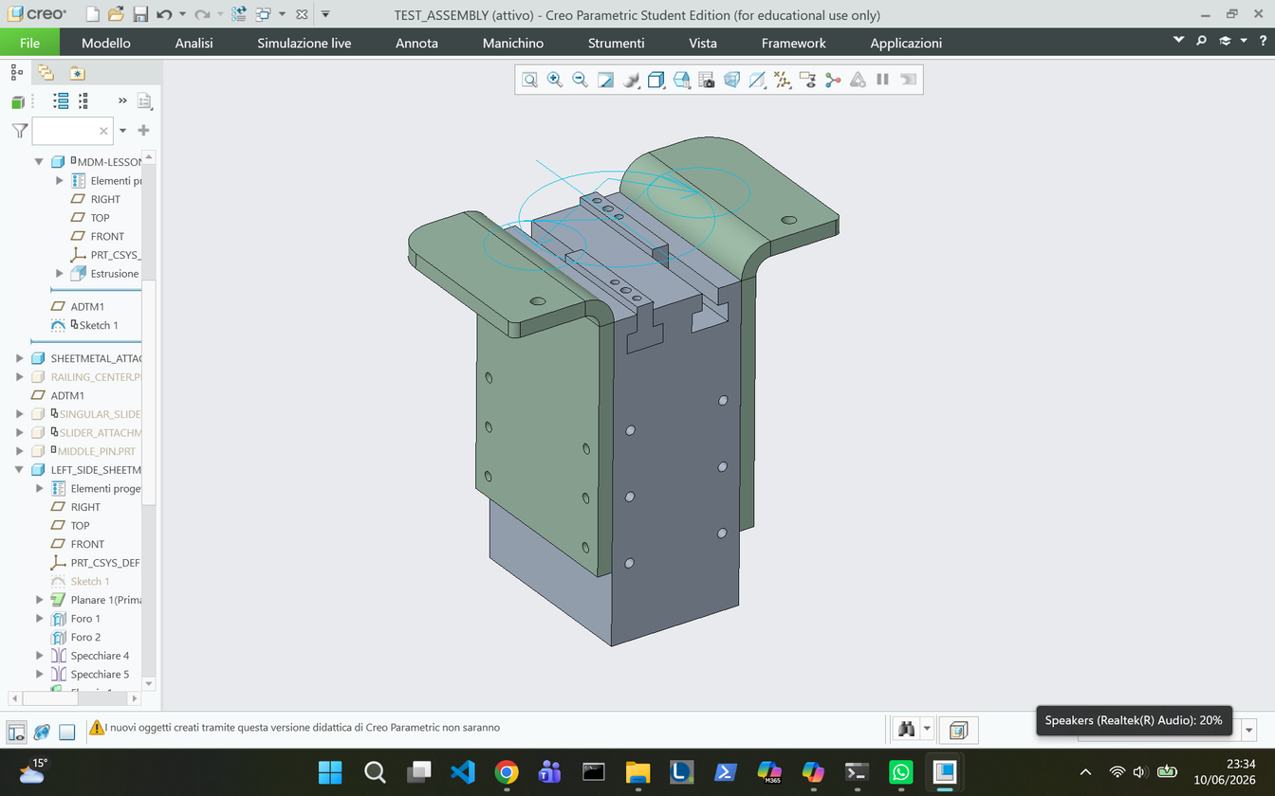
Fingers positions
One finger is rigidly connected to one of the motors.
The other two fingers are connected to the second motor through additional attachments. The attachments and pivot screws placement allow the fingers to follow a curved trajectory that facilitates adjustment to components of different diameters.
Lateral supports for the rotating fingers
18

Slide 19
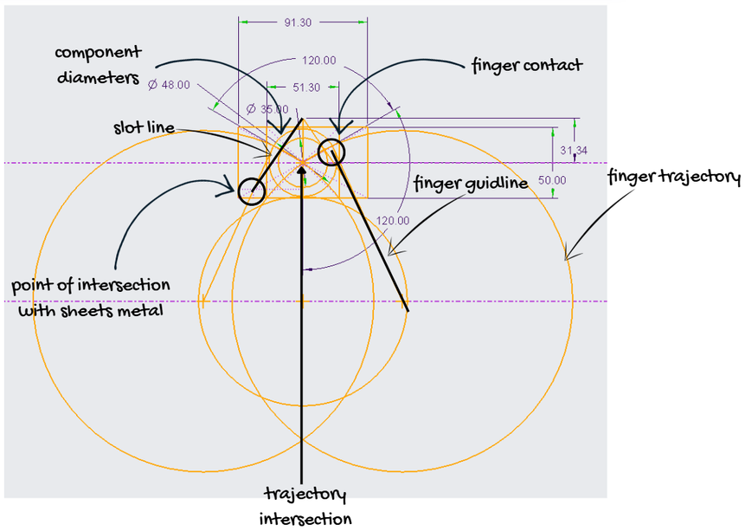
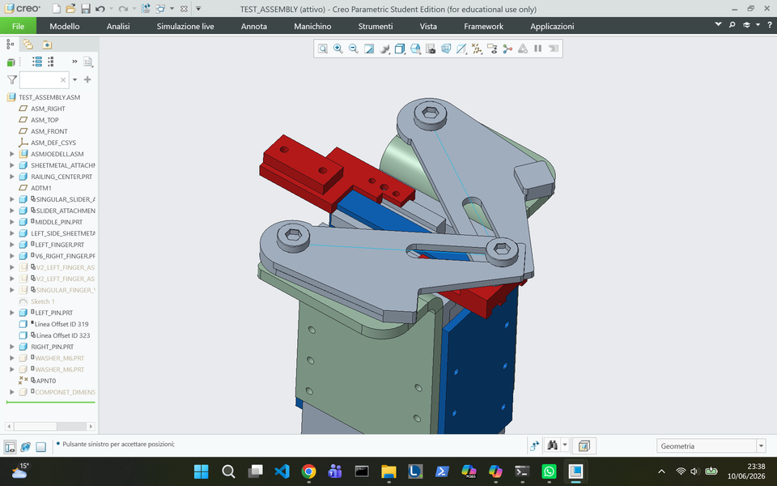
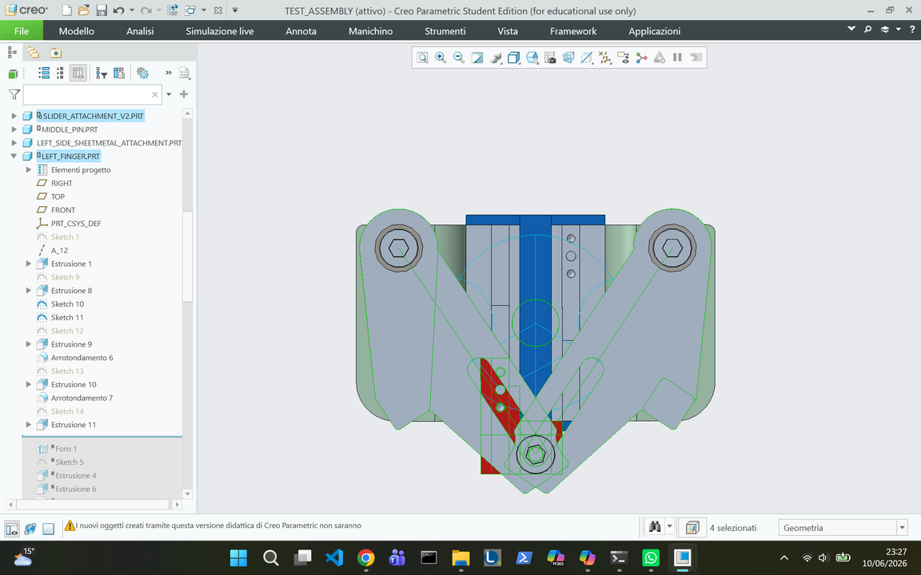
2-Fingers Dynamics
FINGERS TRAJECTORY DESIGN:
  Safe areas defined using min/max component diameters (+3 mm margin).
  Fingers arranged at 120° to avoid flange interference.
  Large circles = theoretical fingertip trajectories during closing.
  The geometry of the slot: we considered the point where the pin screw will be attached to the slider and the intersection of the trajectory line from the centre of the larger trajectory circles.
  The trajectory intersection ensures the synchronous radial motion of the two lateral fingers.
19

Slide 20
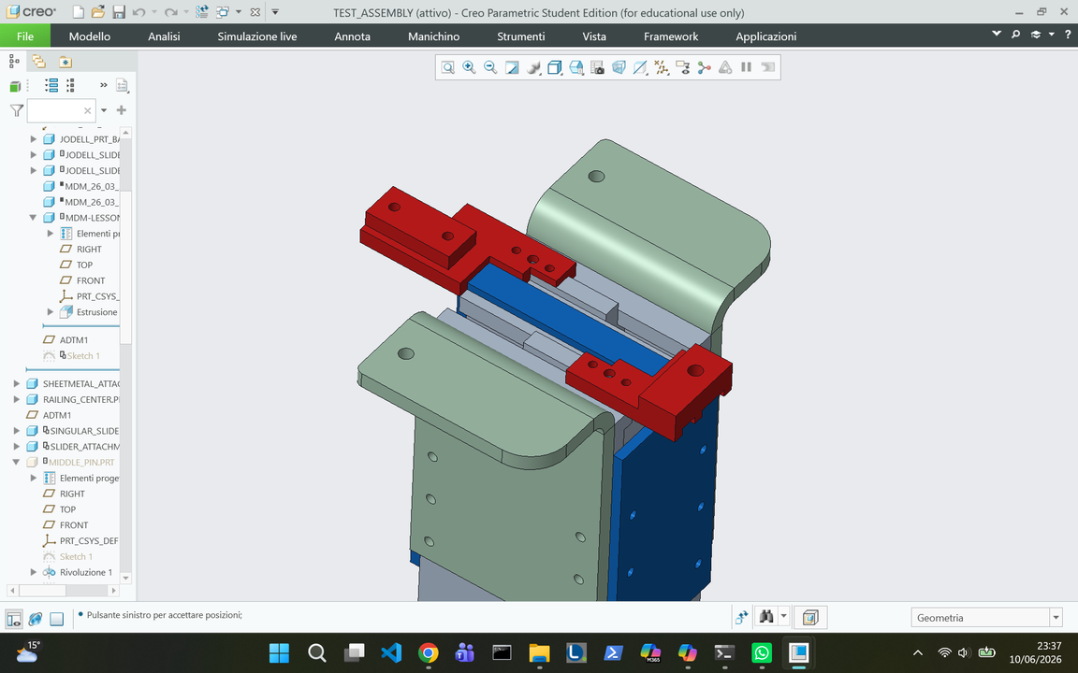
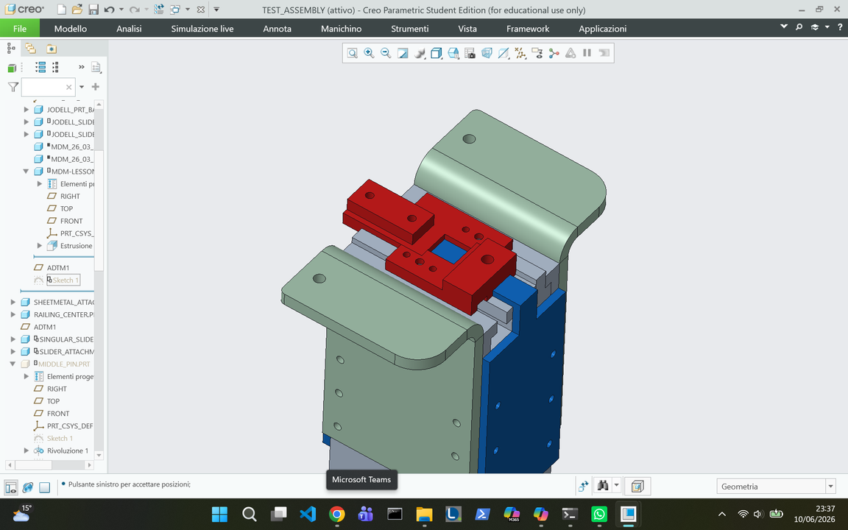
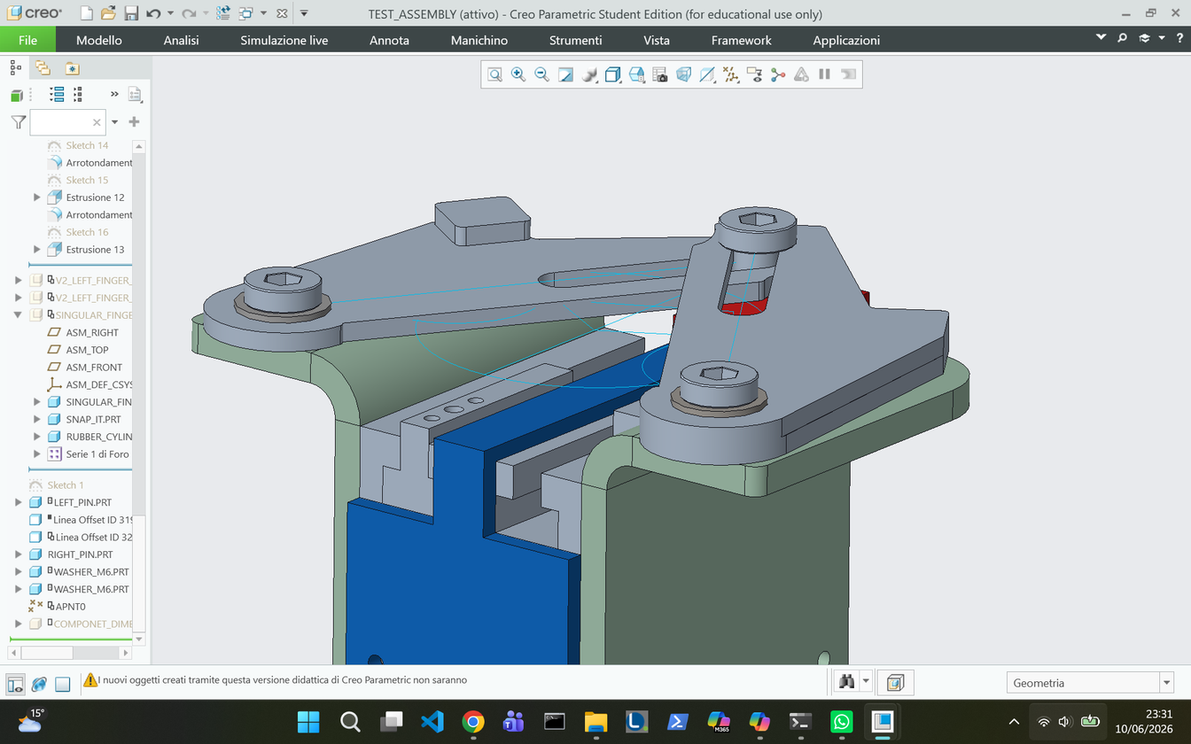
Additional features
SLIDERS ATTACHEMENTS:
To prevent the sliders from colliding with each other and to fully exploit the available range of motion, the slider attachments were designed to interlock with one another.
WASHERS:
The washer between the sliding plates that hold the two fingers is to reduce wear and tear during motor motion.
washers
20

Slide 21
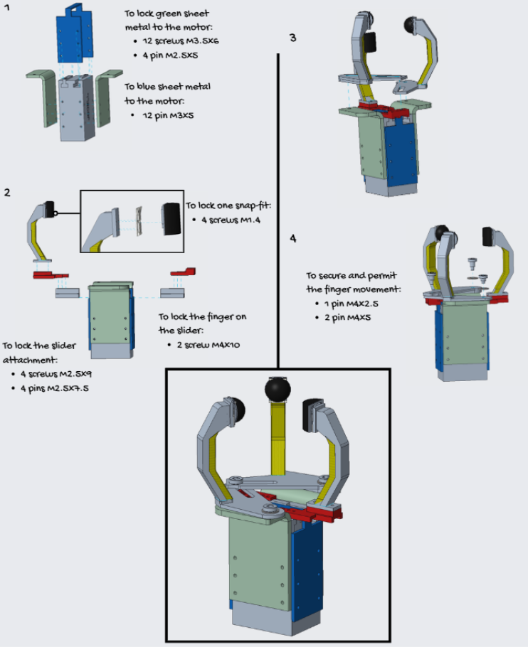
Assembly
MAIN ASSEMBLY STEPS:
  The assembly begins with the Jodell motor's body, incorporating its two main support metal sheets.
  The singular finger is mounted to one slider, whereas the two lateral fingers are linked to the second slider via rigid bars, pins, and slots.
  The rubber attachments are fitted into the snap-fit guides located at the ends of each finger. This procedure facilitates modular assembly of the gripper and ensures efficient maintenance.
21

Slide 22
Requirement verification
How the solution presented satisfies the given requirements:
Requirement | Description | How it is satisfied
Safe grasping | The gripper must avoid the threaded screw, bolt sections and interference with the flanges | The height of the fingers allows the gripper to reach the lower cylindrical surface, while the 120° movement of the fingers allows them to avoid the flanges
Adaptability | The gripper must be able to grasp components with different diameters | The finger movement is based on the angular position of the safe areas. Since the fingers keep an angle of about 120°, the gripper can adapt to different diameters
Stability | The component must remain stable during the pick-up operation | The use of two spherical contacts and one cylindrical contact improves stability and reduces the risk of tilting
Compliant grasping | The gripper should provide a softer and more adaptable contact with the component surface | The elastomer part on the fingers improves compliance along the component surface, while the rubber attachments help the fingers adapt to the local geometry during the pick-up
Easy assembly | The design should be simple and feasible to assemble | The reduced number of components and the modular finger structure simplify the assembly process
Maintenance | Wearable parts should be easy to replace | The rubber attachments are replaceable and can be changed without disassembling the whole gripper
Compatibility | The mechanism should be compatible with the Jodell motor and its linear sliders. | One finger is connected to one slider and performs a linear movement, while the other two fingers are moved through rigid bars and slots connected to the second slider of the motor
22

Slide 23
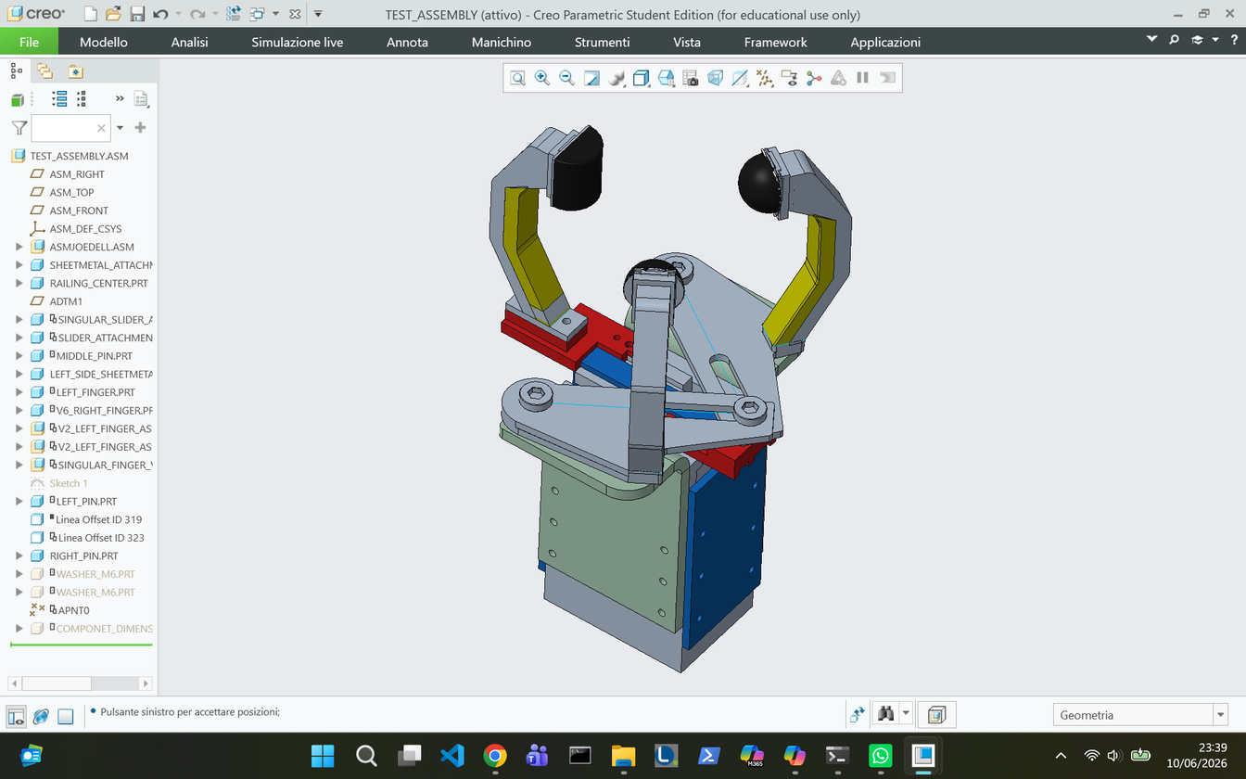
Reasons why this is the best design
The study of previous options has allowed us to arrive at a more refined proposal.
Our final selection balances simplicity and reliability.
MINIMAL COMPONENTS
GRIP ADAPTABILITY
FLEXIBLE MATERIALS
Ease of manufacturing and packaging with minimal maintenance and setup required.
A simple and efficient design that balances the objective of dynamics and adaptability.
Each finger combines a stiff load‑bearing material with a deformable layer that enhances stability
23

Slide 24
Conclusions
The proposed gripper represents a good compromise between functionality, adaptability and manufacturing simplicity. The final solution satisfies the main requirements defined at the beginning of the project, allowing the component to be grasped from the safe lower cylindrical surface while avoiding the restricted areas.
FINAL DESIGN CONSIDERATIONS:
  Stable grip and only safe areas of contact thanks to the three-finger design
  No need for a priori setup
  Easy maintenance with snap-fit rubber substitution
  Adaptable mechanism for different-sized components
  Steel and elastomer for weight support and flexibility
24

Slide 25
The End
MDM Group Project
STEFANIA GERMENA
CHIARA MAGNASCO
CHIARA MASANIELLO

